Slide 1

Chapter 15
Connecting LANs,
Backbone Networks,
and Virtual LANs
15.<number>
Copyright © The McGraw-Hill Companies, Inc. Permission required for reproduction or display.

Slide 2
15-1 CONNECTING DEVICES
In this section, we divide connecting devices into five different categories based on the layer in which they operate in a network.
Topics discussed in this section:
Passive Hubs
Active Hubs
Bridges
Two-Layer Switches
Routers
Three-Layer Switches
Gateways
15.<number>

Slide 3
LANs do not normally operate in isolation. They are connected to one another or to the Internet.
To connect LANs, or segments ofLANs, we use connecting devices.
Connecting devices can operate in different layers of the Internet model. The focus is only on those that operate in the physical and data link layers
15.<number>

Slide 4
The five categories contain devices which can be defined as
Those which operate below the physical layer such as a passive hub.
2. Those which operate at the physical layer (a repeater or an active hub).
3. Those which operate at the physical and data link layers (a bridge or a two-layer switch).
4. Those which operate at the physical, data link, and network layers (a router or a three-layer switch).
5. Those which can operate at all five layers (a gateway).
15.<number>

Slide 5

Figure 15.1 Five categories of connecting devices
15.<number>

Slide 6

Figure 15.2 A repeater connecting two segments of a LAN
A repeater connects segments of a LAN., A repeater does not actually connect two LANs; it connects two segments of the same LAN.
A repeater forwards every frame – there is no filtering.
A repeater is a regenerator, not an amplifier.
15.<number>

Slide 7

Figure 15.3 Function of a repeater
15.<number>

Slide 8

Figure 15.4 A hierarchy of hubs
A hub is a multi-port repeater, used in star-wired LANs (Ethernet).
Because of the amount of traffic and collisions, hubs can only be used in small network configurations.
15.<number>

Slide 9
A bridge operates in both the physical and the data link layer. As a physical layer device, it regenerates the signal it receives.
As a data link layer device, the bridge can check the physical (MAC) addresses (source and destination) contained in the frame.
A bridge has a table used in
filtering decisions.
Filtering
Difference in functionality between a bridge and a repeater:
A bridge has filtering capability. It can check the destination address of a frame and decide if the frame should be forwarded or dropped.
If the frame is to be forwarded, the decision must specify the port. A bridge has a table that maps addresses to ports.
15.<number>

Slide 10

Figure 15.5 A bridge connecting two LANs
15.<number>

Slide 11

Note
A bridge does not change the physical (MAC) addresses in a frame.
15.<number>

Slide 12

Figure 15.6 A learning bridge and the process of learning
15.<number>

Slide 13

Figure 15.11 Routers connecting independent LANs and WANs
Routers
A router is a three-layer device that routes packets based on their logical addresses (host-to-host addressing).
A router normally connects LANs and WANs in the Internet and has a routing table that is used for making decisions about the route.
The routing tables are normally dynamic and are updated using routing protocols.
15.<number>

Slide 14
15-2 BACKBONE NETWORKS
A backbone network allows several LANs to be connected. In a backbone network, no station is directly connected to the backbone; the stations are part of a LAN, and the backbone connects the LANs.
The backbone is itself a LAN that uses a LAN protocol such as Ethernet; each connection to the backbone is itself another LAN.
Bus Backbone
Star Backbone
Connecting Remote LANs
15.<number>

Slide 15
Note
In a bus backbone, the topology
of the backbone is a bus.
15.<number>

Slide 16
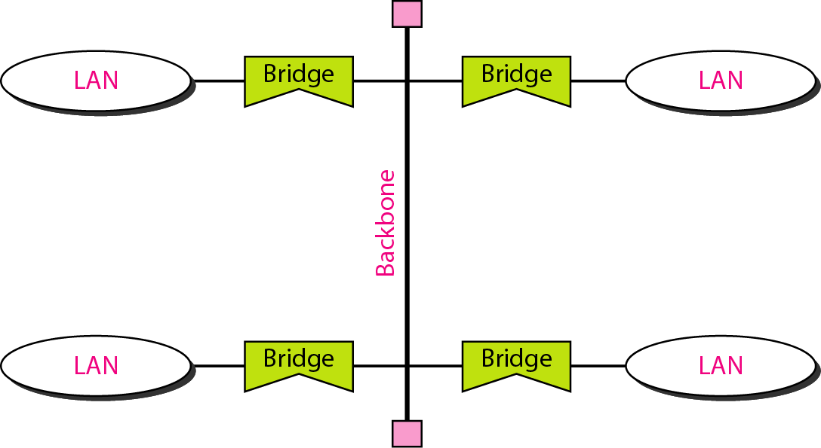
Figure 15.12 Bus backbone
Bus backbones are normally used as a distribution backbone to connect different buildings in an organization.
Each building can comprise either a single LAN or another backbone
15.<number>

Slide 17
Note
In a star backbone, the topology of the backbone is a star;
the backbone is just one switch.
15.<number>

Slide 18
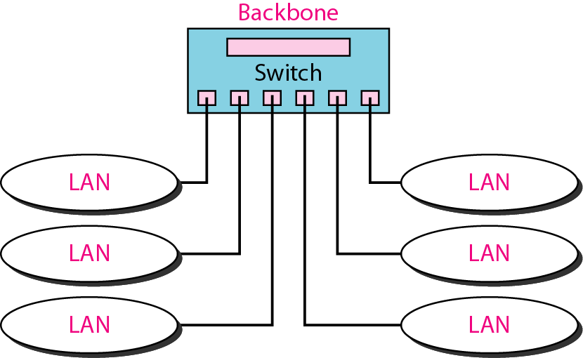
Figure 15.13 Star backbone
Note that, in this configuration, the switch does the job of the backbone and at the same time connects the LANs.
15.<number>

Slide 19
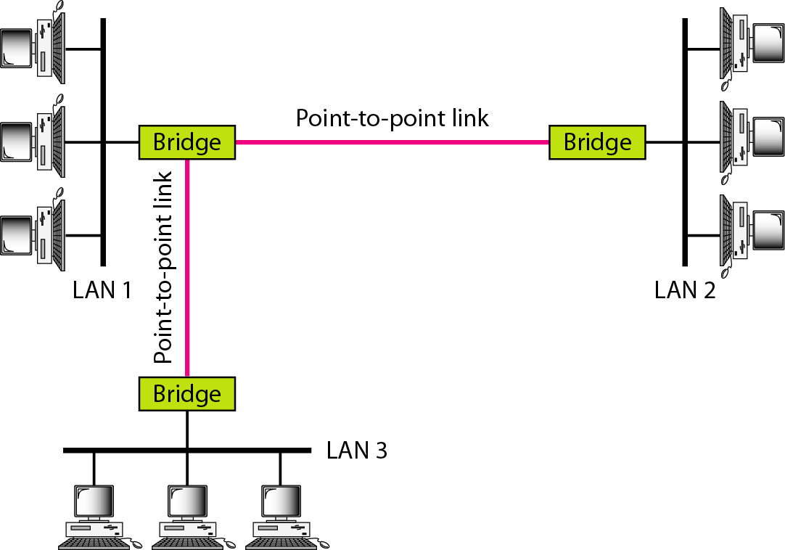
Connecting remote LANs with bridges
Another common application for a backbone network is to connect remote LANs.
This type of backbone network is useful when a company has several offices with LANs and needs to connect them.
The bridges act as connecting devices connecting LANs and point-to-point networks
15.<number>

Slide 20
Note
A point-to-point link acts as a LAN in a remote backbone connected by
remote bridges.
15.<number>

Slide 21
15-3 VIRTUAL LANs
We can roughly define a virtual local area network (VLAN) as a local area network configured by software, not by physical wiring.
Topics discussed in this section:
Membership
Configuration
Communication between Switches
IEEE Standard
Advantages
15.<number>

Slide 22
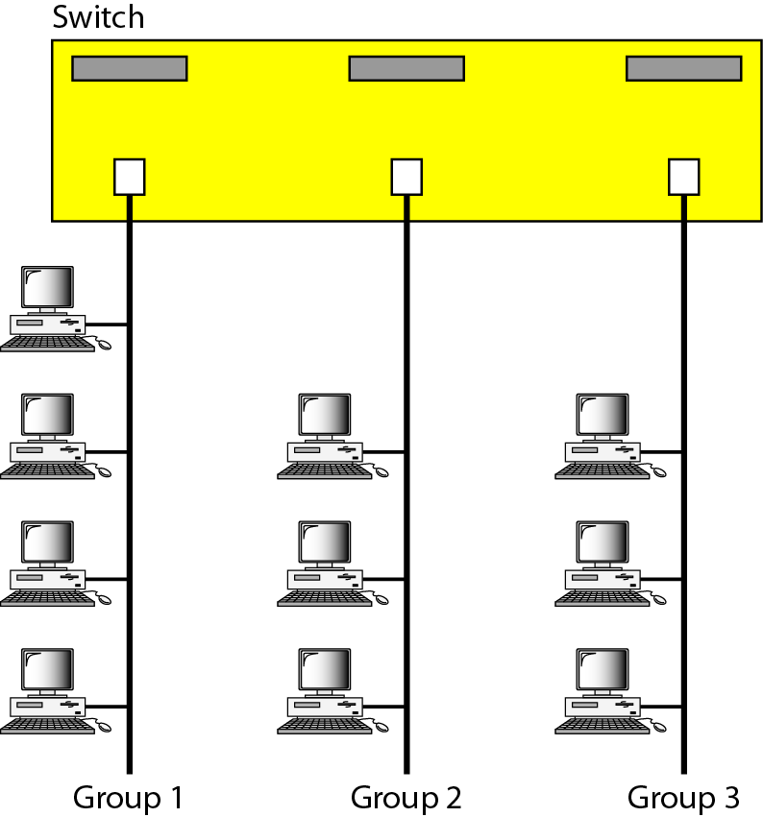
A switch connecting three LANs
Figure shows a switched LAN in an engineering firm in which 10 stations are grouped into three LANs that are connected by a switch.
The first four engineers work together as the first group, the next three engineers work together as the second group, and the last three engineers work together as the third group. The LAN is configured to allow this arrangement.
15.<number>

Slide 23

A switch using VLAN software
Figure shows the same switched LAN divided into VLANs. The whole idea of VLAN technology is to divide a LAN into logical, instead of physical, segments. A LAN can be divided into several logical LANs called VLANs.
Each VLAN is a work group in the organization.
If a person moves from one group to another, there is no need to change the physical configuration.
The group membership in VLANs is defined by software, not hardware. Any station can be logically moved to another VLAN.
All members belonging to a VLAN can receive broadcast messages sent to that particular VLAN.
15.<number>

Slide 24

Two switches in a backbone using VLAN software
VLAN technology even allows the grouping of stations connected to different switches in a VLAN. Figure shows a backbone local area network with two switches and three VLANs. Stations from switches A and B belong to each VLAN.
This is a good configuration for a company with two separate buildings.
Each building can have its own switched LAN connected by a backbone.
15.<number>

Slide 25
Note
VLANs create broadcast domains.
15.<number>

